Slide 1
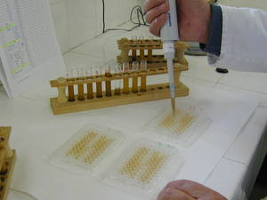
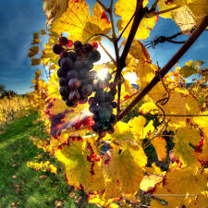
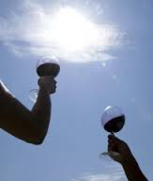
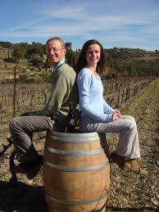

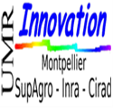

ClimWine 2016 Bordeaux, April 10-13
Adaptation Strategies to Climate Change
in the French wine industry:
The role of networks connecting
wine producers and researchers
James Boyer, Jean-Marc Touzard
With the support of the Laccave project

Slide 2
Context
Innovations have been progressively adopted by wine producers for 8000 years…
Acceleration of innovations in the two last centuries, linked to
i) geographical expansion of viticulture
ii) integration of scientific knowledge, facing different issues: pest, productivity, mechanization, quality, diversification...
During the last decades, the relations between wine producers and research centers or universities have play a key role in the development of vineyard in the “new world” (Giuliani et al. 205, 2010) and in different regional clusters (Touzard 2013)
What is the role of these relations in adaptation to climate change in the wine industry?

Slide 3
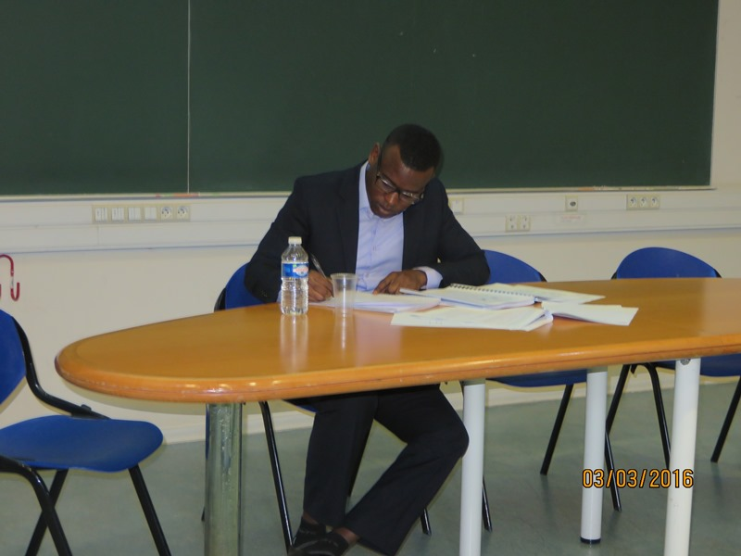
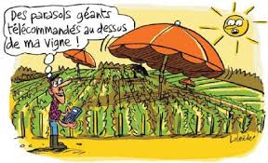
PhD James Boyer
(March 2016)
What is the role of « local relationships between actors of R&D and wine producers » in the adaptation to climate change, in the French wine regions ?

Slide 4
Method
A strategic and relational definition of adaptation:
Perception of CC
Actions in 5 main domains:
varieties, vine monitoring, pest managt, enology, spatial and economic
Interactions with others: advice networks analysis (ego c.)
Confronting « bottom up » and « top down » approaches
wine producers vs actors of the R&D
Double survey in different wine regions
  General information on farm/farmer vs R&D actor/organisation
  Perceptions of climate change (both)
  Innovations implemented vs R&D actions in the 5 domaines
  Advice network for each domain of innovation or R&D
Econometric model: dependant variable: proxi of adaptation
explicative variables: conditions adaptation

Slide 5
BOTTOM UP
Confronting
bottom-up and
top down analysis
In the wine innovation system
TOP DOWN

Slide 6
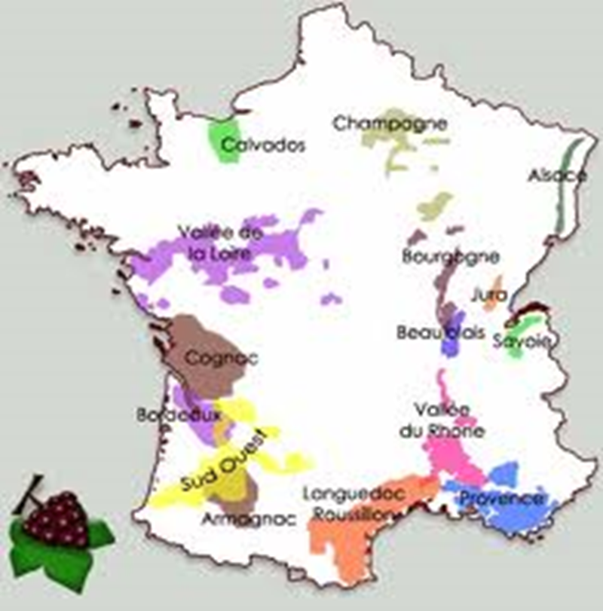
A double Survey in 3 vineyards
87 AOP wine producers, 94 R&D actors
Continental climate
R&D by interprofession
26 wine producers
19 R&D actors (124)
Atlantic Climate
R&D Inra, university,
Interprofession, Agr.Ch…
29 wine producers
34 R&D actors (270)
Méditerranéen climate
Inra, ICV, Agr. Ch.
weak interprofessions,
32 wine producers
41 R&D actors (290)

Slide 7
Results from the wine producers survey
Econometric model:
 | sex | Form | anc | Resp | UTH | EVOLCA | pca | stajsup | Bio
PERC | 0,03 | 0,11 | 0,03* | 1,85**** | -0,01 | - | 1,44**** | 0,67*
Innov | -0,75 | 0,79*** | 0,05** | - | 0,01 | -0,36 | 1,06** | 1,27** | 2.67**
Perception of CC impact in the 3 vineyards
Expected Advice network for adaptation to CC
All domains of innovation
plantation
Private advice
wine
New var
research
agric.chamb.
harvest
Vine monit
supplyers
Interprof.
pest
water
peers

Slide 8
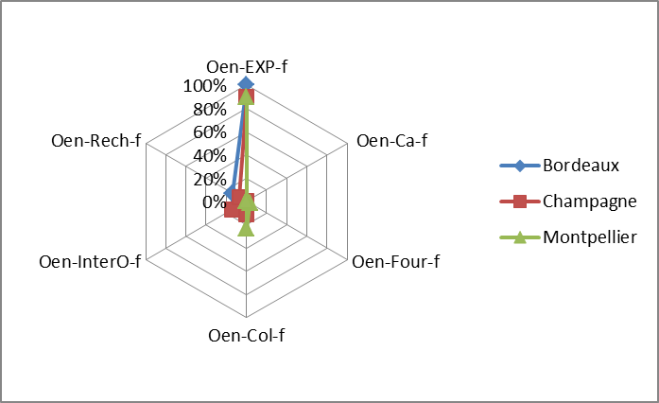
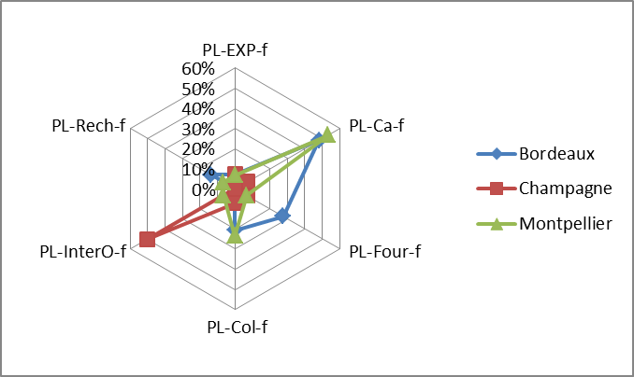
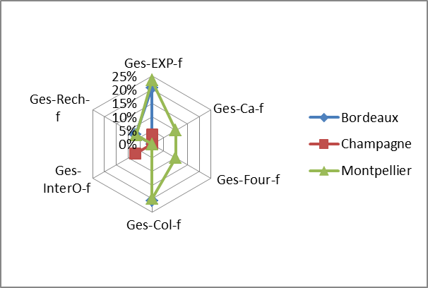
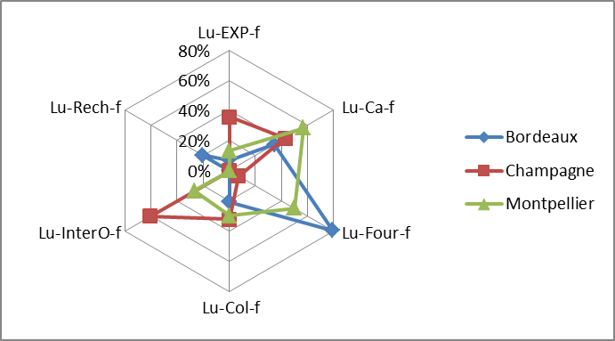
Advice networks in different domains of innovations
Winemaking innovation
Plantations
Pest management
Harvest management

Slide 9
Results fom the R&D actors survey
Variables indépendantes |  | Nombre d'individus | Implication CC | Moyenne contacts professionnels
 | Chercheurs | 62 | 3,35** | 15
Acteurs R&D | Expérimentateurs | 32 | 2,78 | 47**
 | Chambre d'agriculture | 13 | 2,38 | 49***
Organisme | Interpro R&D | 8 | 2,63 | 77 ***
 | IFV | 11 | 3,36** | 23
 | Recherche/université | 62 | 3,35** | 15
 | Bordeaux | 34 | 3,15* | 19
Région | Champagne | 19 | 2,53 | 48***
 | Languedoc-Roussillon | 41 | 3,46** | 22
 | Conduite Vignoble | 23 | 3,52** | 28
 | Luttes maladies | 26 | 2,65 | 25
 | Matériel végétal | 12 | 4*** | 14
Domaine de recherche | Œnologie | 19 | 3 | 23
 | Stratégies spatiales économiques | 14 | 3 | 39**
Projet CC | Non | 52 | 2,56 | 26
 | Oui | 42 | 3,90*** | 27
Responsabilité | Oui | 47 | 3,21 | 23
 | Non | 47 | 3,11 | 30
International stay | Non | 57 | 3,04 | 30*
 | Oui | 37 | 3,35 | 19
Sexe | F | 31 | 2,81 | 18
 | M | 63 | 3,33* | 30
Moyenne âge |  | 46
publication |  | 24 |  | ***-
Total général |  | 94 | 3,16 | 26
ICC_{ki} = β₀+ β₁(DREC)_{i} + β₂(Strucf)_{i}+ β₃ (SEXE)_{i}+β₄(AGE)_{i}+β₅(INTERN)_{i} +β₆ (PRO)_{i}+ ε_{i}
CAVIX_{ki} = β₀+ β₁(DREC)_{i} + β₂(Strucf)_{i}+ β₃ (SEXE)_{i}+β₄(AGE)_{i}+β₅(INTERN)_{i} +β₆ (RESO)_{i}+ ε_{i}

Slide 10
Conclusion (1): Farmers survey vs R&D survey
At farmer level adaptation strategies can be represented by indicators of perception, innovations and advice networks
No link between innovation for CC and economic dimension
3 set of factors have significant effect on strategy
  Personnal trajectory of the wine producer (training, professional responsabilities, presence of interns)
  Regional effect due to specific impact of CC, but also to different R&D networks and institutions (clusters effect)
  « socio-technical model » (organic vs conventionnal)
At R&D actors level contribution to adaptation can be represented by indicators of publications and advice networks
No impact of (chosen) personal factors diversity of profiles..
Three main « dualities »
  Researchers more aware on CC vs developers more connected
  Influence of topics and discipline (genetician vs socio-economist)
  Regional effect, capturing networks, local issues, strategic choices

Slide 11
Conclusion (2) : more generic insights
Convergency between perception of wine producers and orientation of research in each region, but not always efficient connexions…
Importance of the regional dimension for adaptation : not only related to CC impacts, but also to the regional governance, with key role of « interprofession »
Need to specify the value chains, according to quality conventions : conventional vs organic (for AOC), but also PGI, Cognac, no IG wine
Personnal trajectories : role of entrepreneurship and involvement for both categories of actors.
Knowledge networks for adaptation: connecting dissemination of farmers’ knowledge (management of climate variability) and the involvement of R&D actors in scientific production and dissemination: need of more events, platforms, forums.. Open and coordinated
To complete the analysis by including other interactions, actors, and sources of information (web, press, policy, friendly network…)

Slide 12
Résultats et discussions
1- Les vignobles connaissent des évolutions économiques différentes
Evolution du prix moyen par hectolitre
2- Sur le plan structurel, les SI des vignobles sont très proches
Institutions ou organisations de recherche et d’enseignement
Organisations d’expérimentation et de conseil (IFV, CA…..)
Organisations et instituions de la filière
Institutions périphériques (DRAAF, FranceAgrimer)
Institutions de financement et des institutions médiatiques

Slide 13
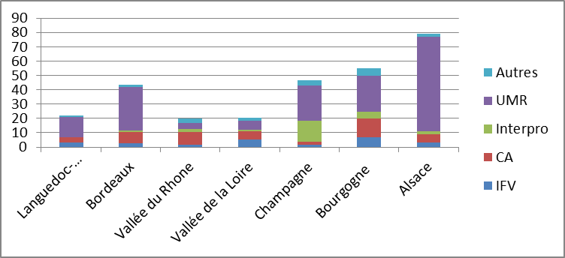
3- Effet de l’intensité de la R&D
ETP totaux par millier d’hectares mobilisés dans la recherche par vignoble
4- Effet de l’implication des Interprofessions dans la R&D
Relation entre Valorisation du vin et implication des interprofessions dans la R&D

